Slide 1
2018-19 Program Review Process
August 10, 2017

Slide 2
Program Review Templates
Templates remain unchanged
  Two templates are available
    Program Review Update
    Comprehensive Program Review
  Links to templates are available in the program review link:
  https://accreditation.imperial.edu/docs/2019/

Slide 3
Comprehensive Program Review
Requires update of 2017-18 goals
SWOT/program health
2019-20 future goals

Slide 4
Program Review Update
Requires update of 2017-18 goals
2019-20 future goals

Slide 5
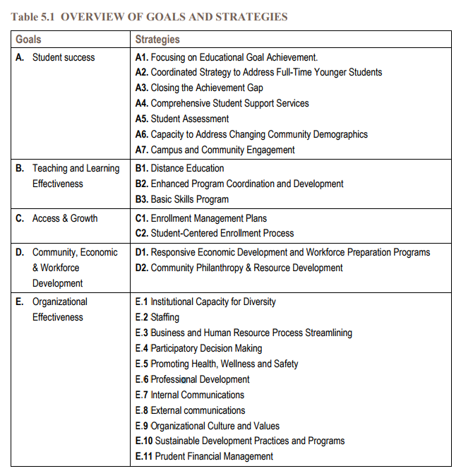

Slide 6
SPOL Trainings
SPOL Trainings will be provided 1 on 1
  Please call or email to reserve a time/date
  Check program review link to download documents
SPOL will be used for budget enhancement requests, but not for general budgets
SPOL will be locked on12/7/2018

Slide 7
Budget Enhancement Process
Program Review is completed in SPOL
11/30/2018
Program Review is approved by Chair/Dean/VP
12/1 – 2/14/2019
SPOL report on budget enhancements is produced and handed to Resource Committees
3/1/2019
Approval and Disapproval are noted on SPOL
5/17/2018
Resource Committees finalize prioritization requests
3/29/2019
Budget and Fiscal Planning Committee makes recommendations
4/19/2019
President’s Cabinet makes funding decisions
5/3/2019
Business Services allocates funding on Banner
6/30/2019

Slide 8
Budget Enhancements
Budget Enhancements will be entered in SPOL Planning Module
Importance of Approval Process
  Quality Assurance
  Clarification on mandatory/legal expense
    “anything that is required by law or obligated by a signed contract/agreement”
Hard copy of objectives and any budget enhancement requests will be provided to Deans/VPs

Slide 9
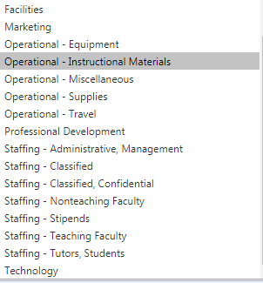
New Budget Enhancement Categories

Slide 10
Questions?
Thank you

