Slide 1
2017-18 Program Review
September 21, 2017

Slide 2
Program Review Templates
Templates remain unchanged
  Two templates are available
    Program Review Update
    Comprehensive Program Review
  Links to templates will be emailed

Slide 3
Comprehensive Program Review
Requires update of 2016-17 goals
SWOT/program health
2018-19 future goals

Slide 4
Program Review Update
Requires update of 2016-17 goals
2018-19 future goals

Slide 5
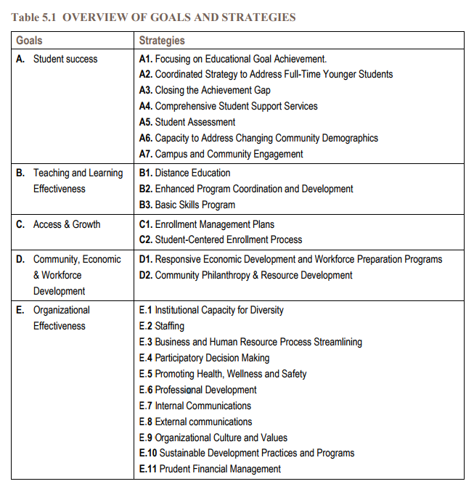

Slide 6
SPOL Trainings
SPOL Training Calendar will soon be confirmed
1-1 Trainings available upon request
SPOL will be used for budget enhancement requests, but not for general budgets
SPOL will be locked on12/4/2017

Slide 7
Budget Enhancement Process
Budget is inputted in SPOL
12/1/2017
Budget is approved by Chair/Dean/VP
1/26 – 2/9/2018
SPOL report on budget enhancements is produced
2/10/2018
Approval and Disapproval are noted on SPOL
5/1/2018
Board Approves Budget
6/20/2018
Resource Committees prioritize requests
3/2/2018
Budget and Fiscal Planning Committee makes recommendations
3/30/2018
President’s Cabinet makes funding decisions
4/30/2018
Business Services allocates funding in Banner
6/30/2018

Slide 8
Budget Enhancements
Budget Enhancements will be entered in SPOL Planning Module
Importance of Approval Process
  Quality Assurance
  Clarification on mandatory/legal expense
    “anything that is required by law or obligated by a signed contract/agreement”
Hard copy of objectives and any budget enhancement requests will be provided to Deans/VPs

Slide 9
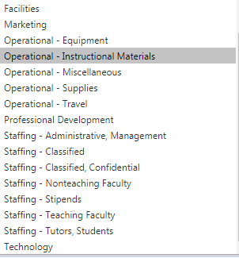
New Budget Enhancement Categories

Slide 10
Questions?
Thank you

