Slide 1


Introduction to
for Teaching Faculty
Melody Chronister, Sr. Systems Analyst/Programmer
Abelardo Huereque, Business Analyst Extraordinaire!
IVC Technology Services

Slide 2
Session Setup
What is Starfish?!
Logging In
What is on the Dashboard?
Profile Setup
Menu Tour
  Appointments
  Students
  My Success Network
  Help

Slide 3
What is Starfish?!
Starfish helps to create an online student success environment, facilitating programs and instructors with the aim of improving student success and retention.
Some of the features of Starfish include:
Viewing support networks
Receiving alerts for concerns and praise for a job well done
Getting electronic referrals and other messages
Signing up online for appointments and calendar management

Slide 4
What is Starfish?!
Current Use:
Instructors
Students
Academic and Lab Support
Student Services
Integrates with:
Banner
Canvas
Argos or other external reporting tools.
Degree Planner
Predictive Analytics
Early Alert
Connect

Slide 5
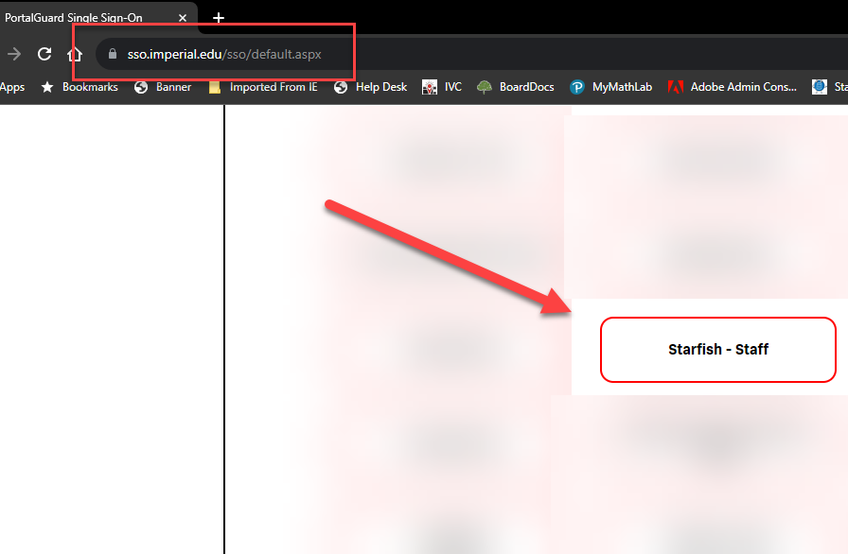
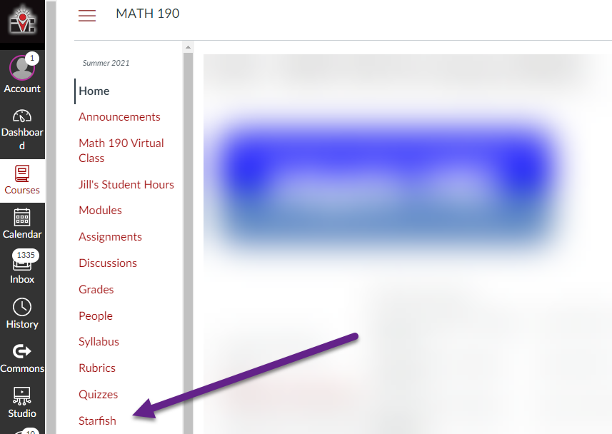
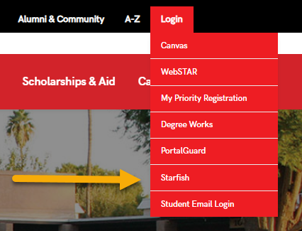
Logging In
Three Options (all connected to SSO)

Slide 6
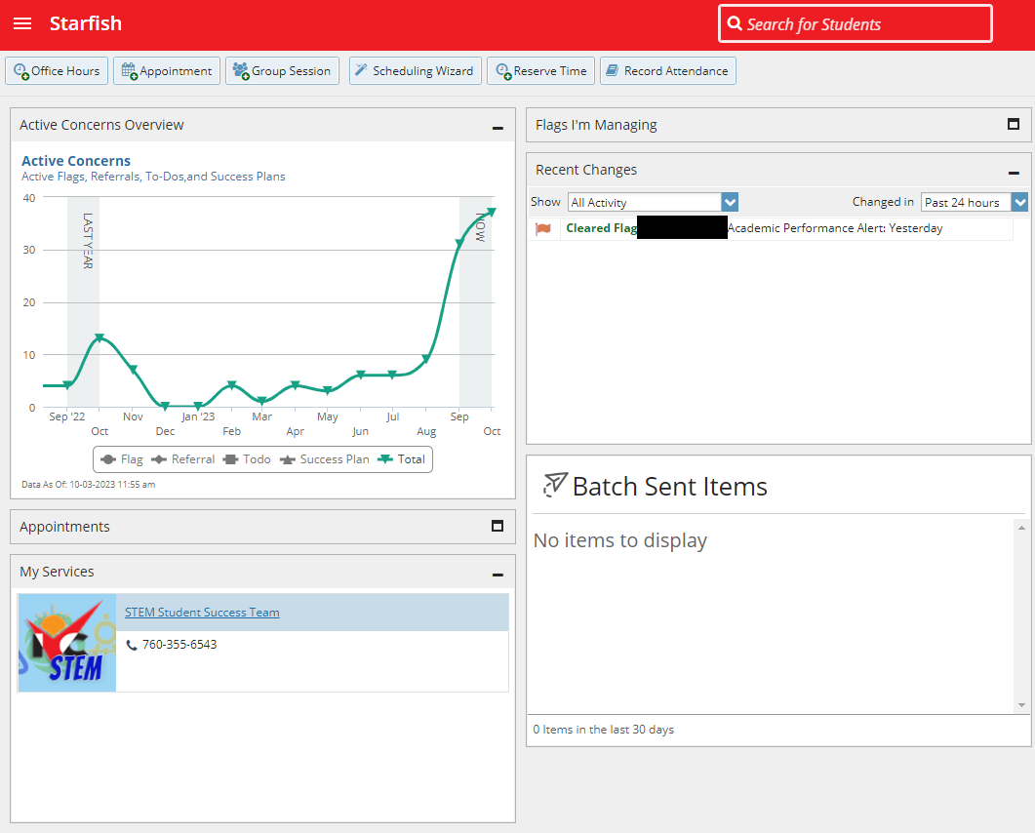
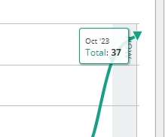
Home
Active Concerns
Flags
Tracking item changes
Bulk Messages
Associated Services

Slide 7
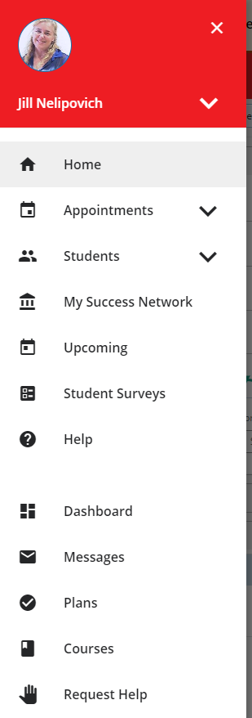
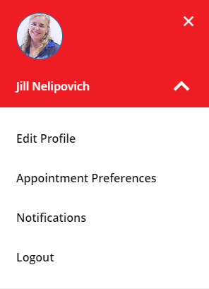
Getting to Your Profile
Here is where you can review and edit your profile settings.

Slide 8
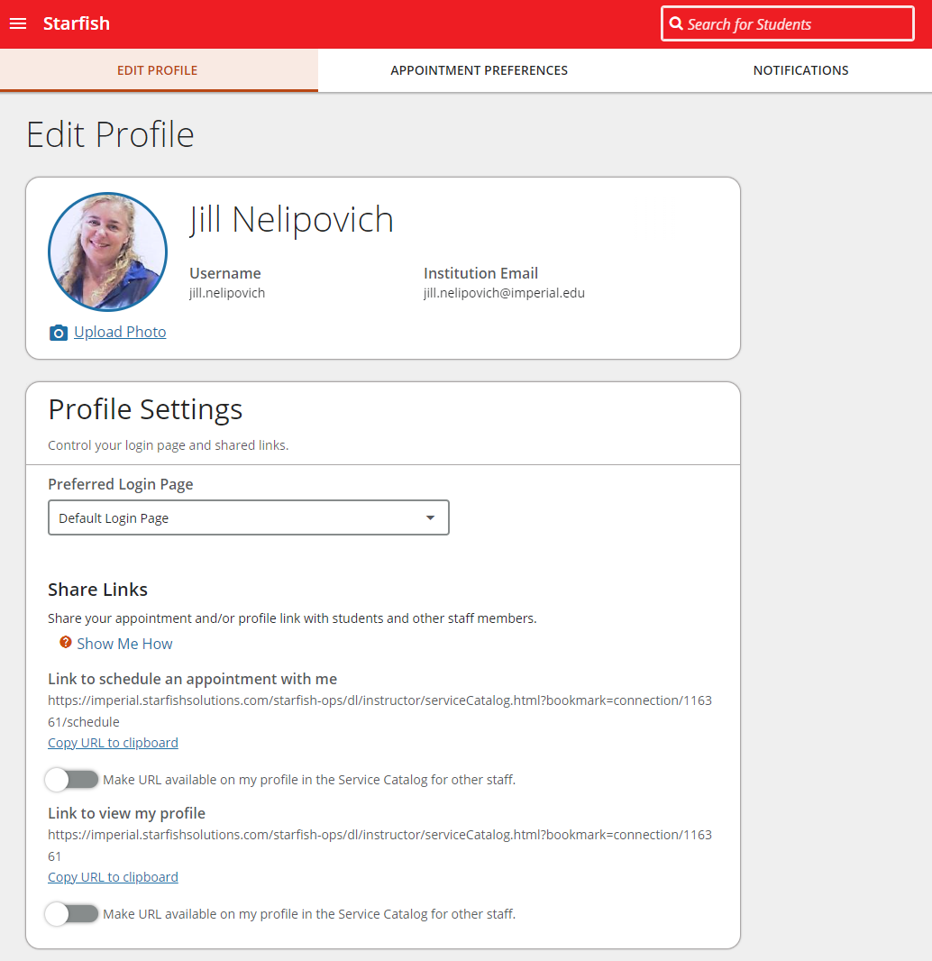
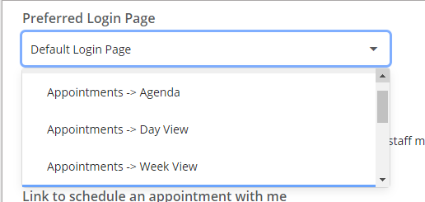
Profile Overview
Change Picture.
Change your Login Page.
Copy calendar and profile links to clipboard.

Slide 9
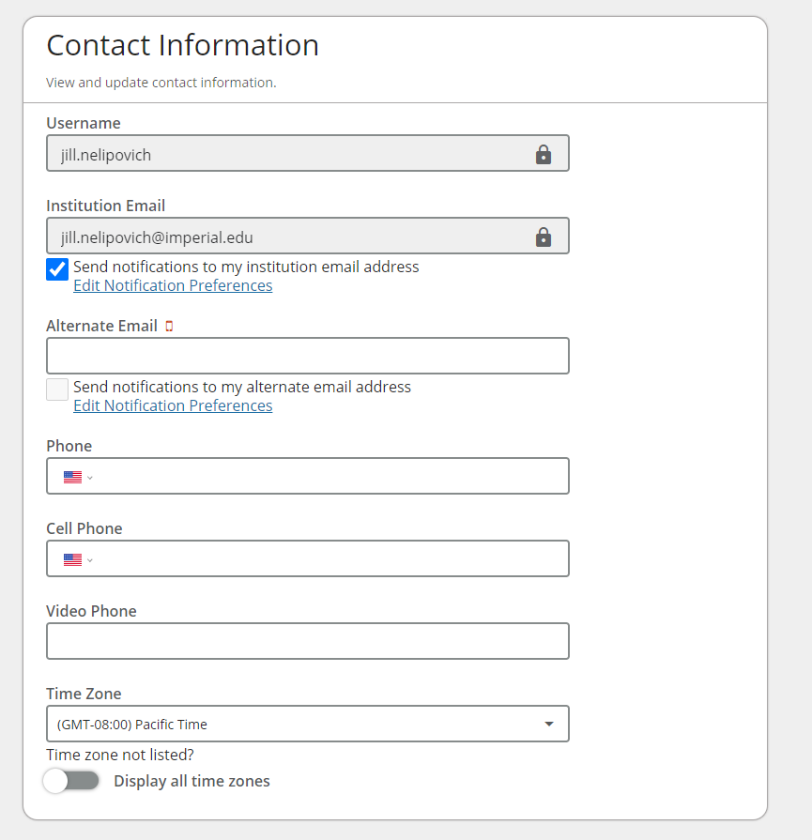
Profile Overview
Add alternative email
Add phone information
Review time zone (default is PT)

Slide 10
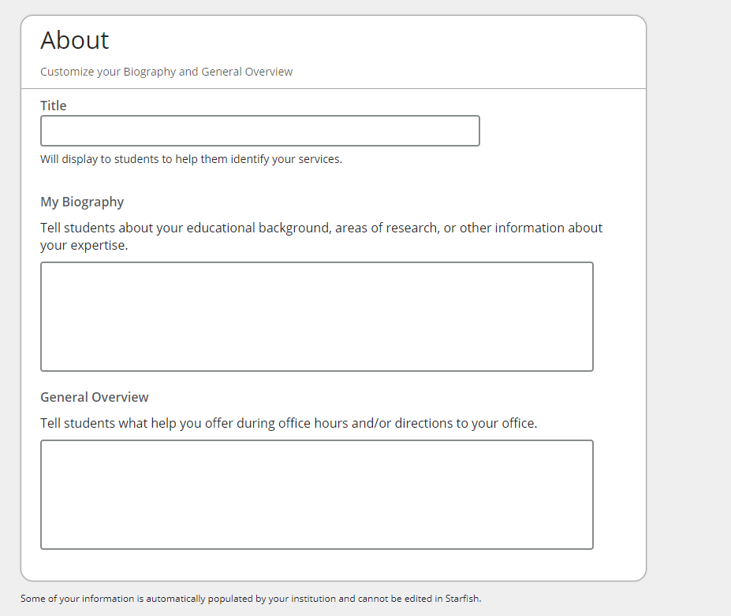
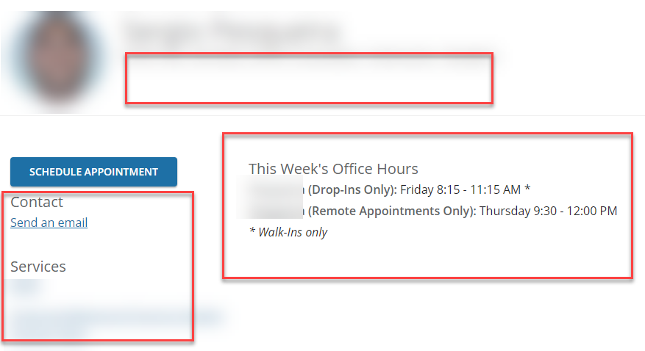
Profile Overview
Add title
Add biography
Add overview
These items show up on
your contact card.

Slide 11
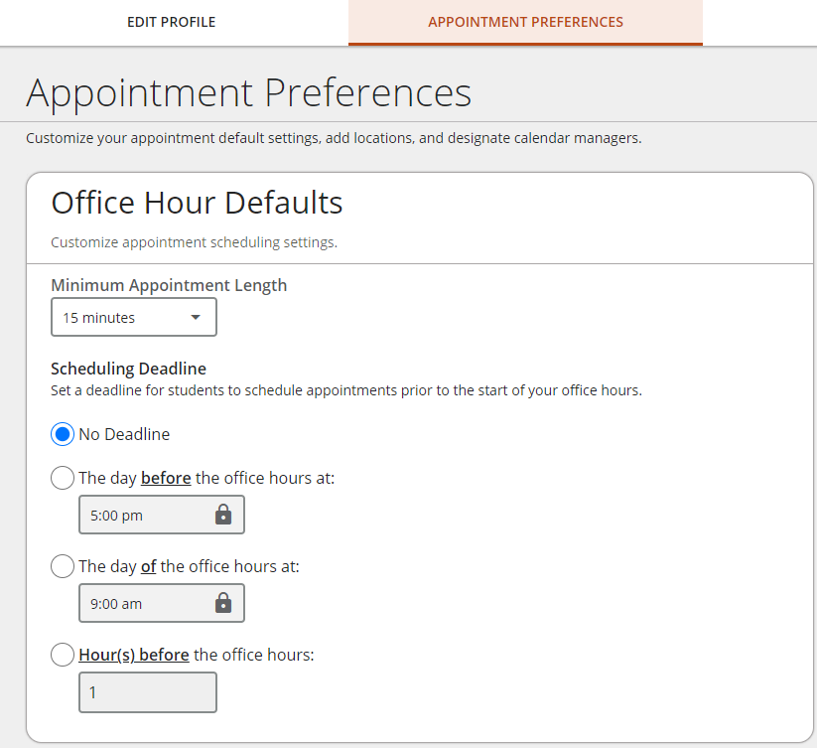
Profile Overview
Set minimum appointment time
Set deadline for student appointment scheduling

Slide 12
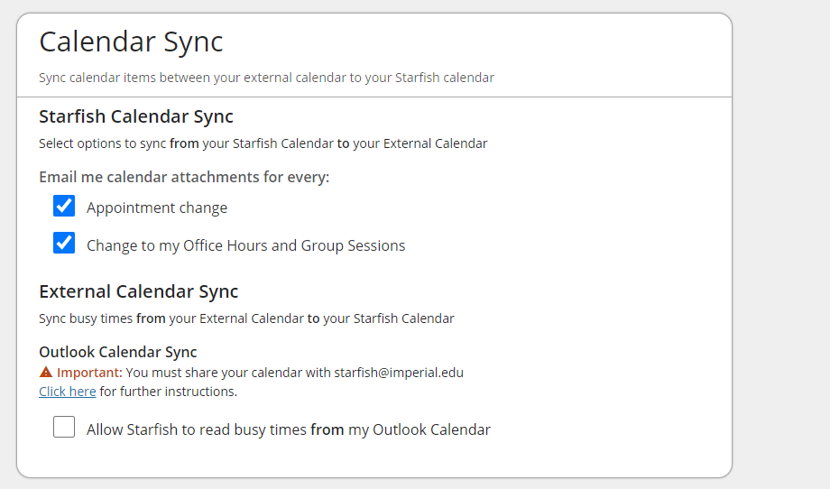
Profile Overview
Change calendar notifications
How we integrate Outlook with Starfish

Slide 13
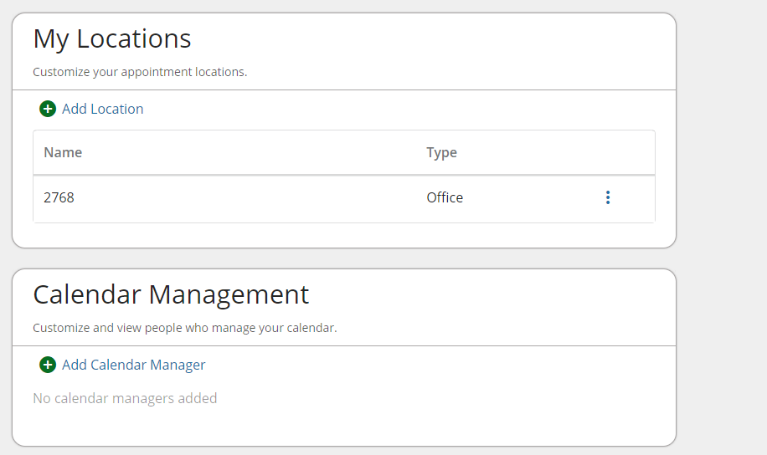
Profile Overview
Add meeting locations that will appear as scheduling options.
Grant access to other users to view your calendar and add/change/remove appointments.

Slide 14
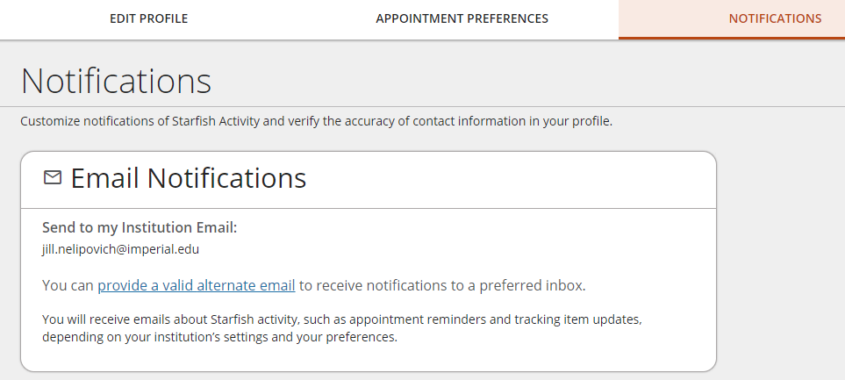
Profile Overview
Designate additional email for notifications (not recommended)

Slide 15
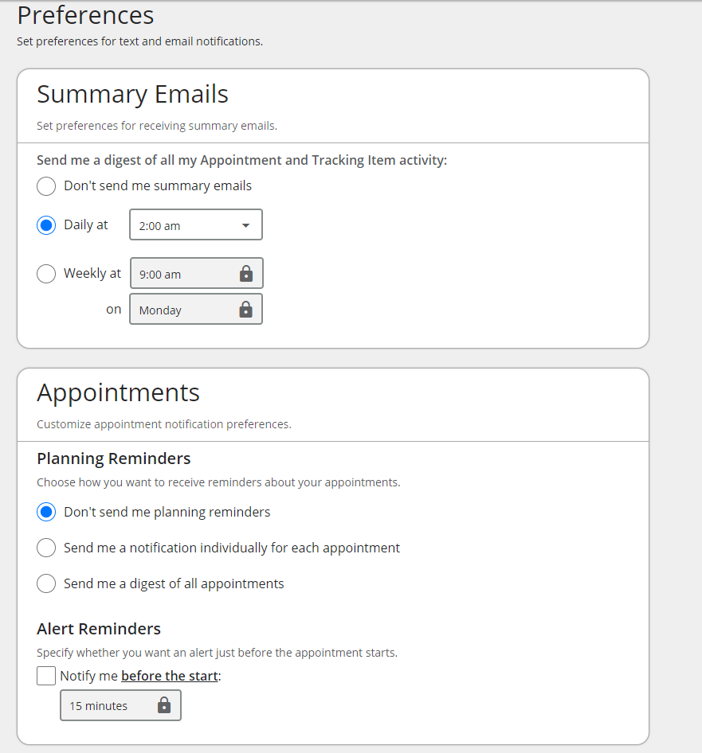
Profile Overview
Identify when you want your Starfish related notifications to be sent via email.
Identify if you want reminders for appointments, and when.

Slide 16
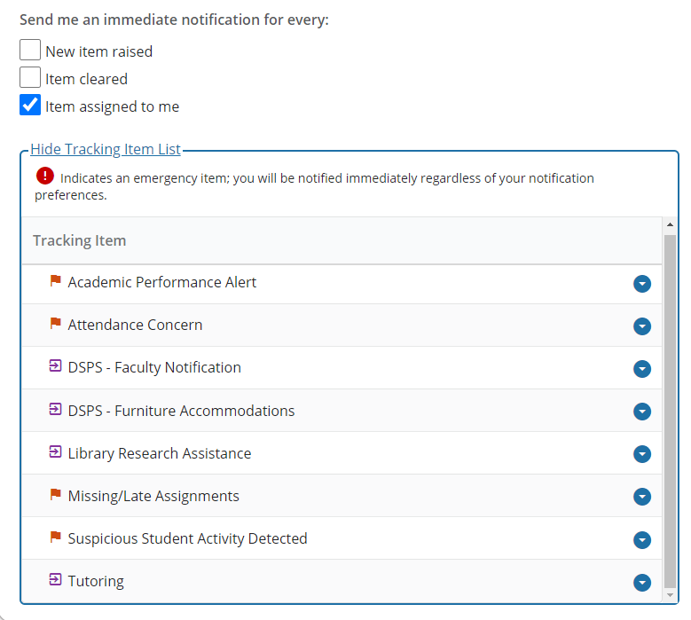
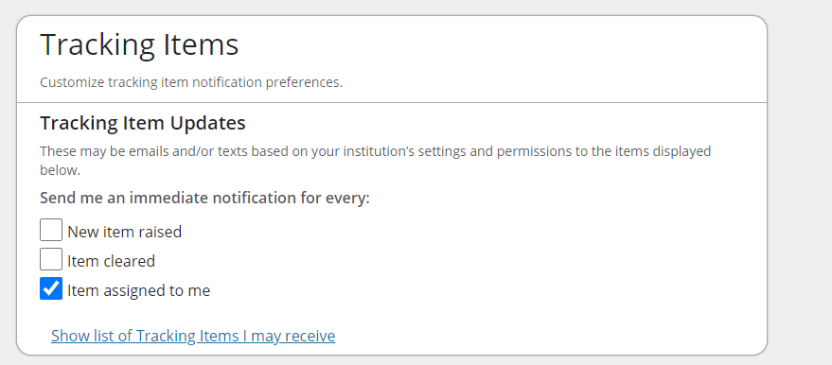
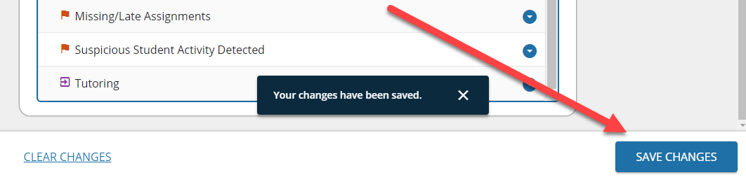
Profile Overview

Slide 17
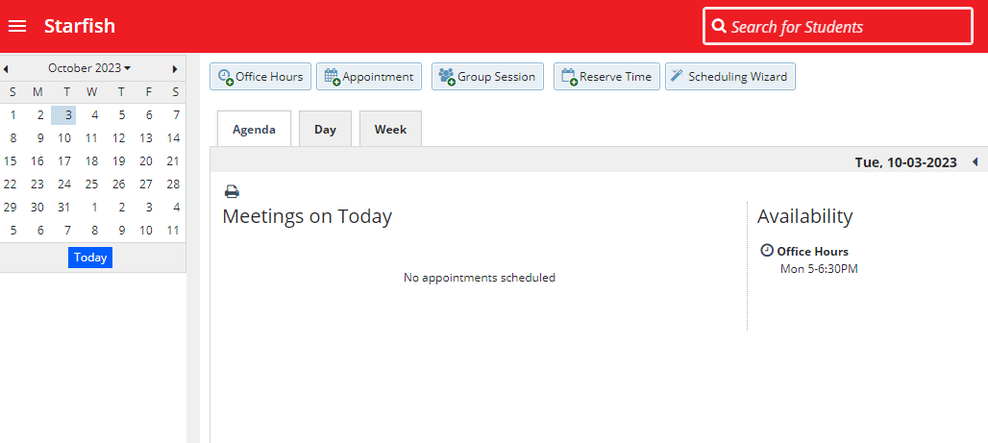
Appointments
Remember to sign up for session 3!

Slide 18
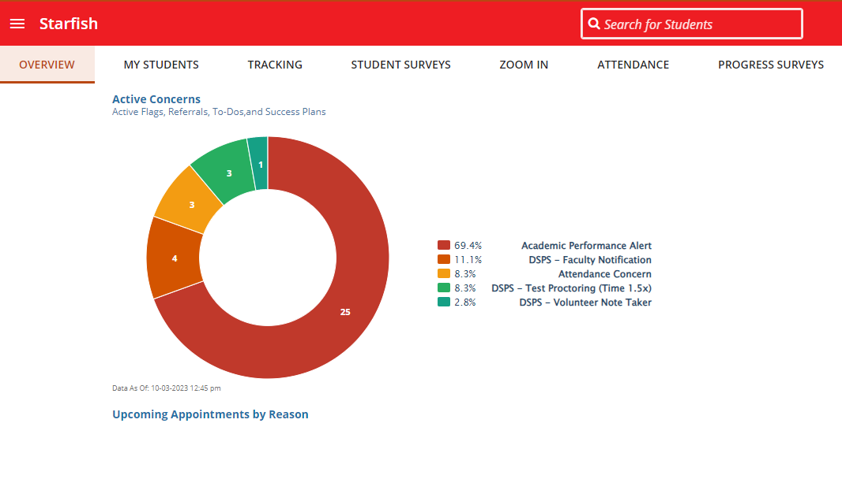
Students

Slide 19
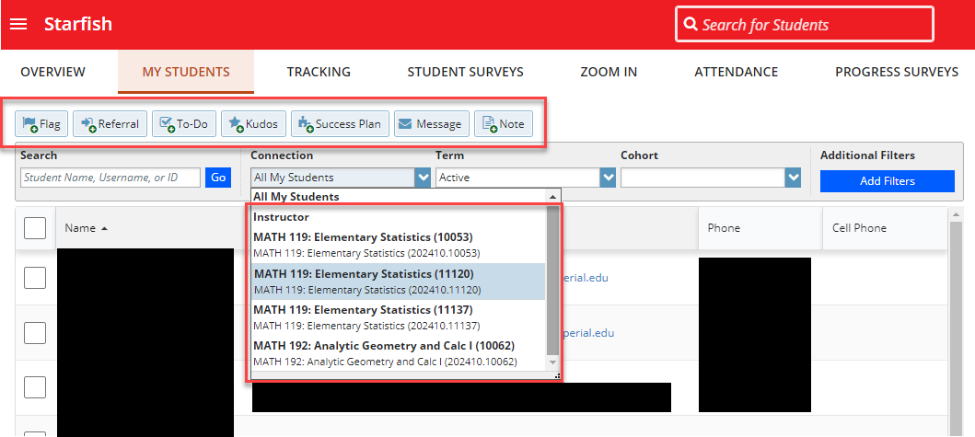
Students

Slide 20
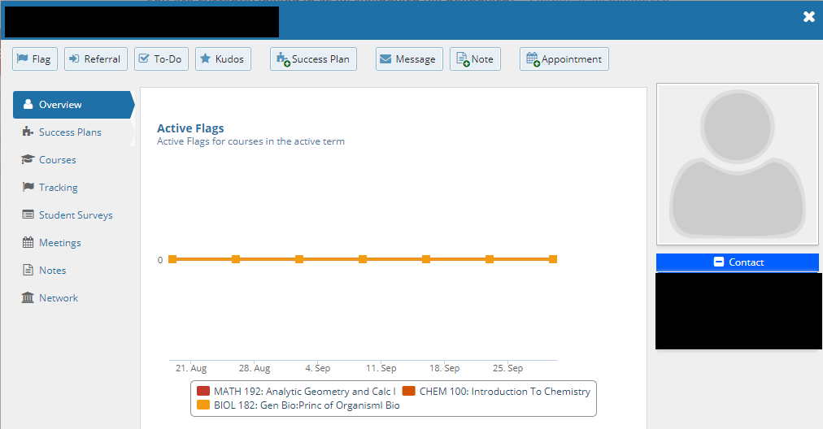
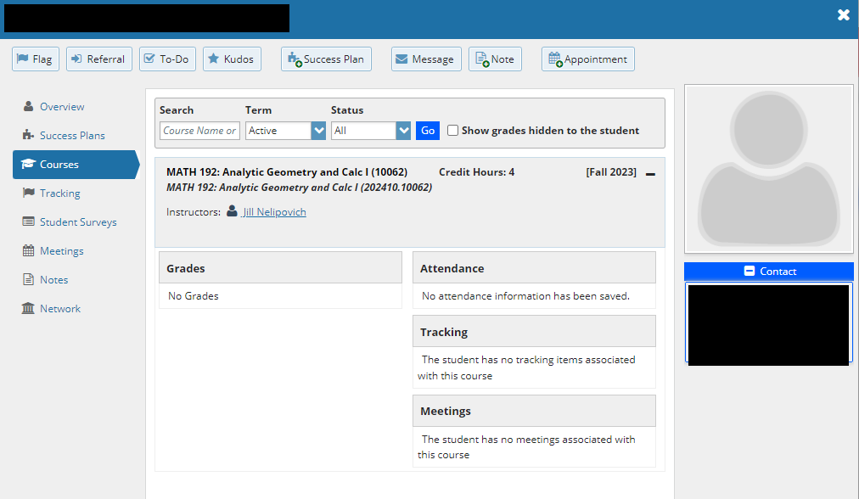
Student Profile Page

Slide 21
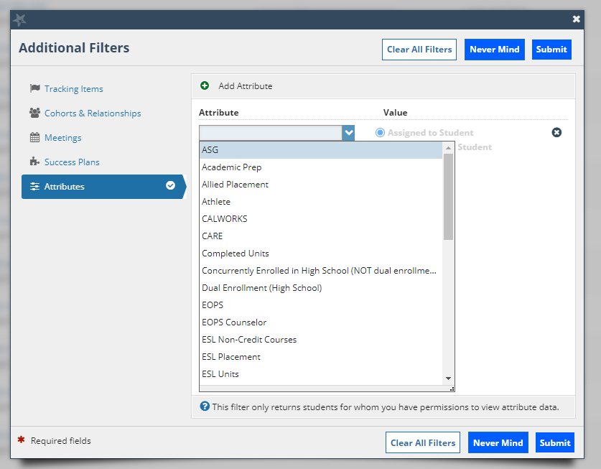
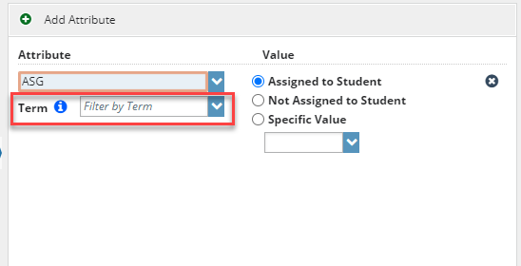
Filters
Leave term blank!

Slide 22
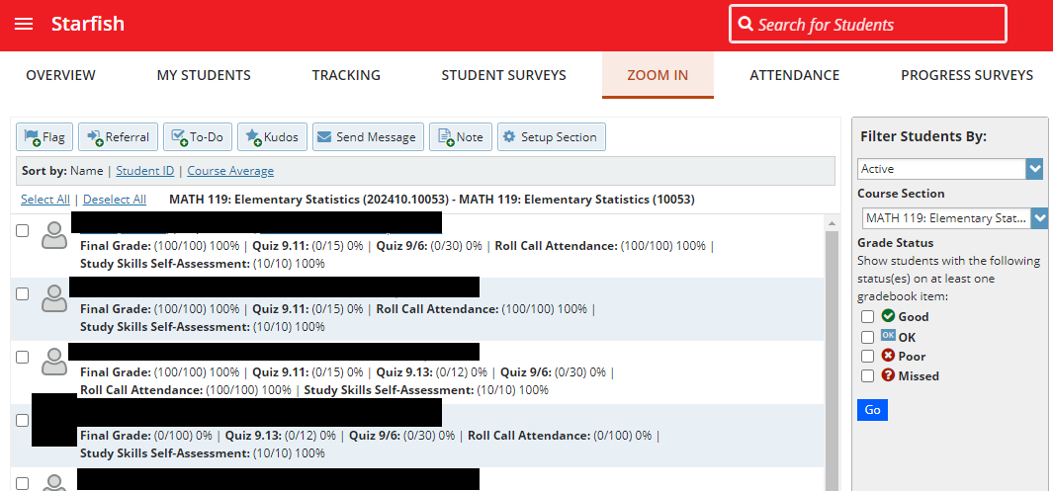
Zoom In

Slide 23
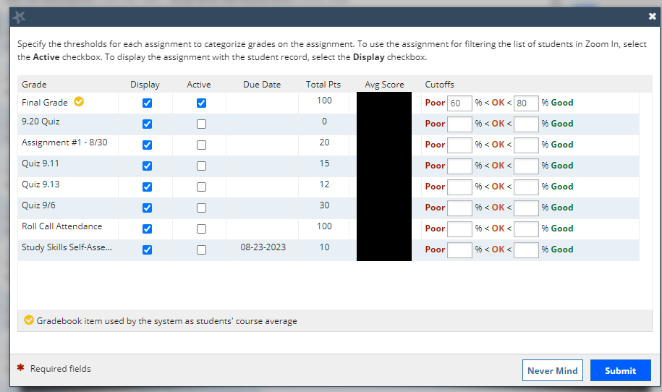
Zoom In Settings

Slide 24
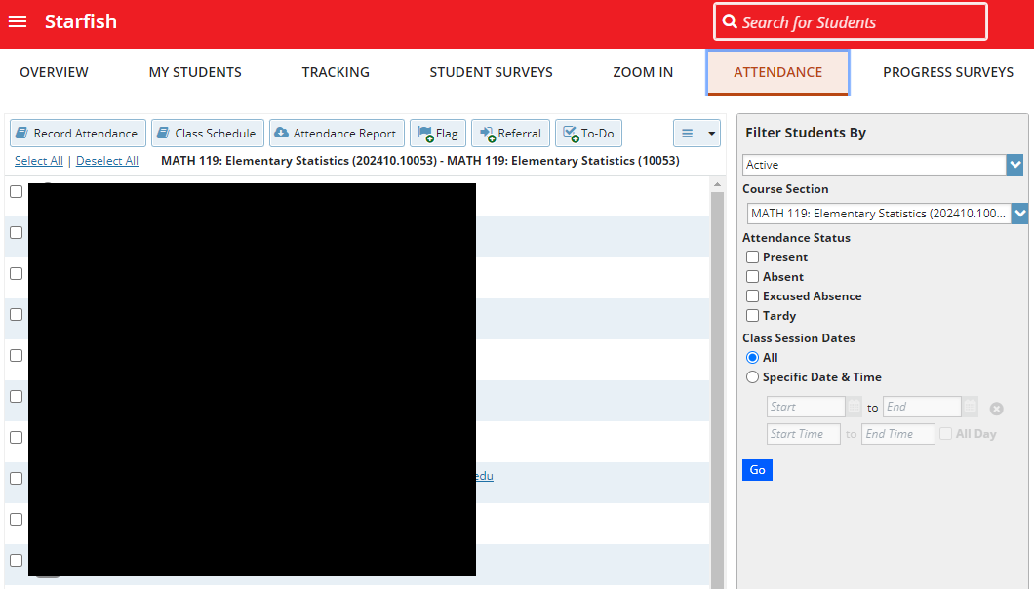
Attendance

Slide 25
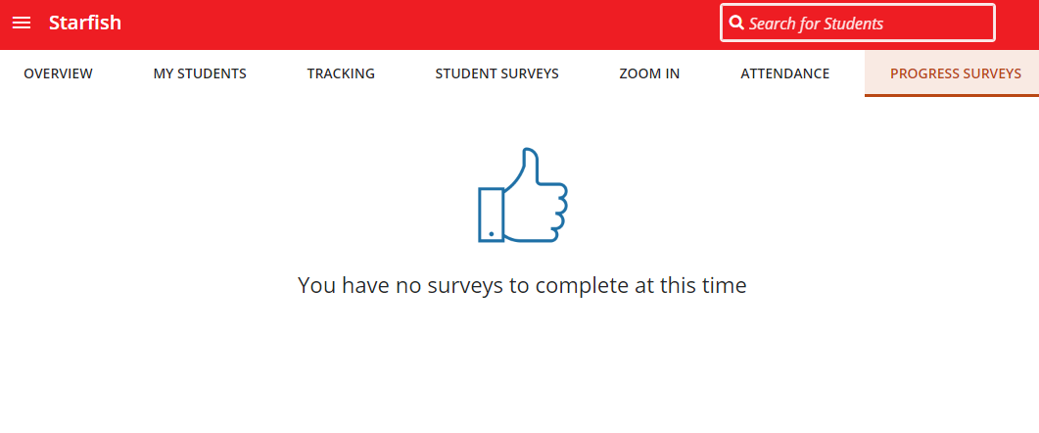
Progress Surveys

Slide 26
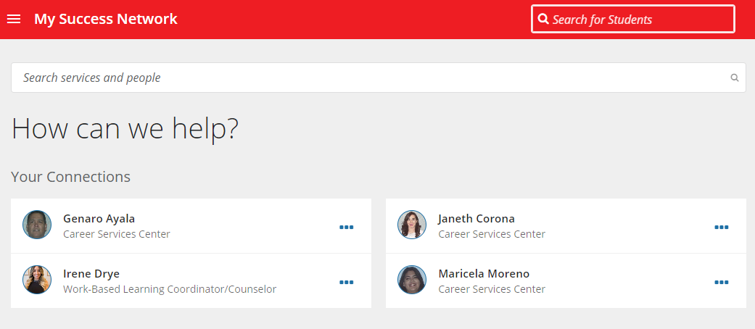
Success Network

Slide 27
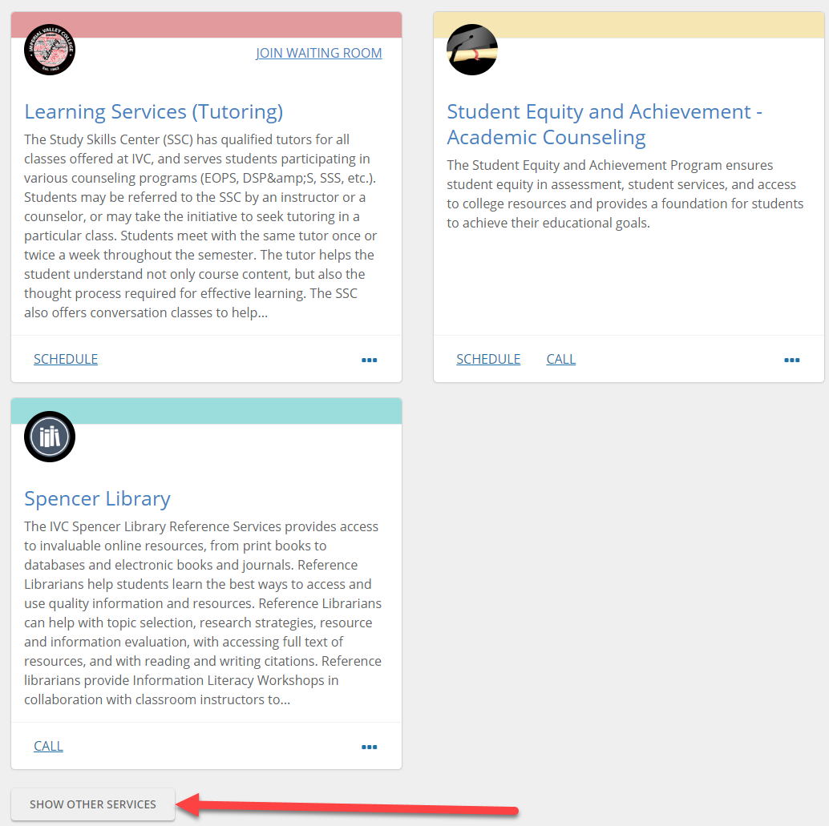
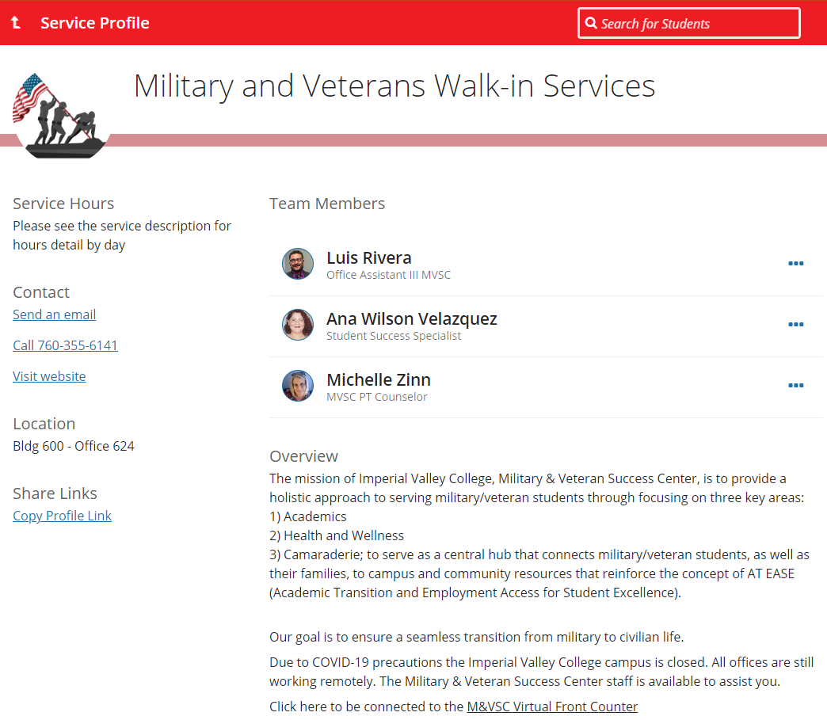
Services

Slide 28
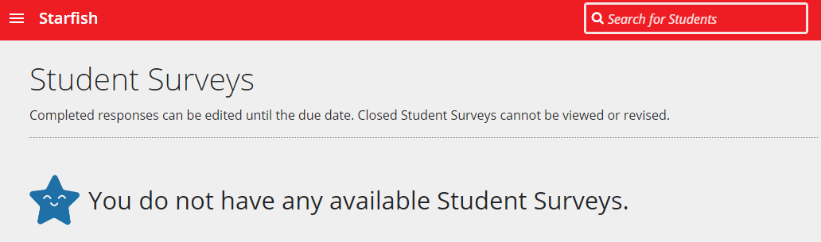
Student Surveys
Shiny and new feature!

Slide 29
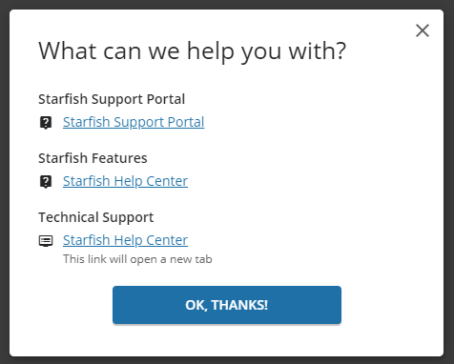
Help!
Starfish has baked in help articles and resources

Slide 30
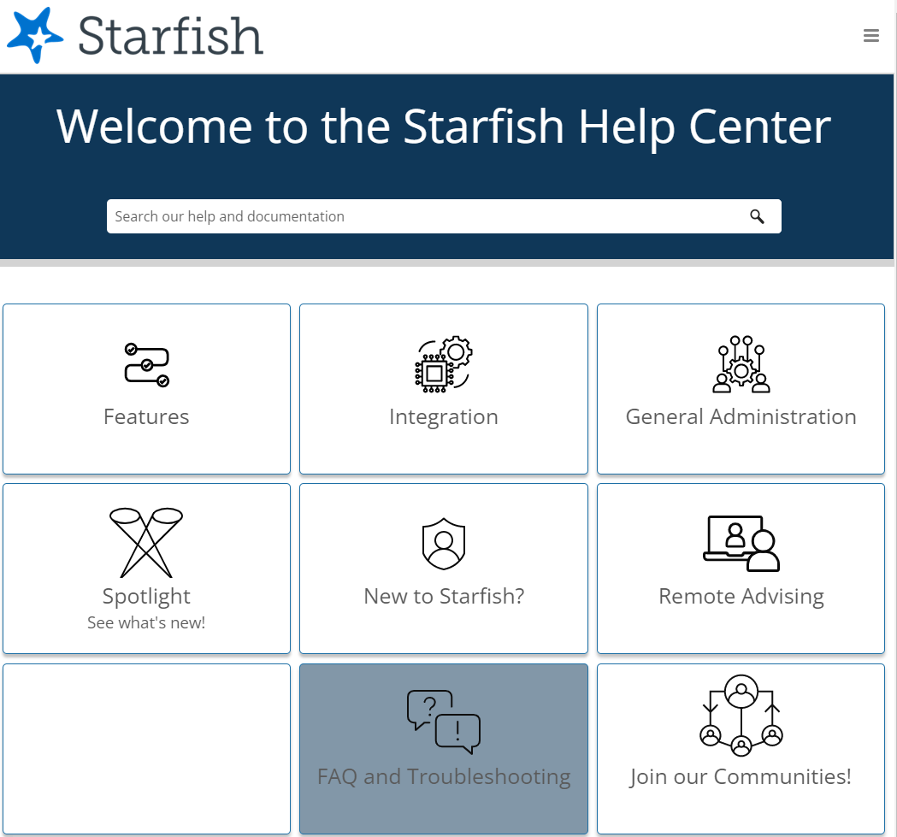
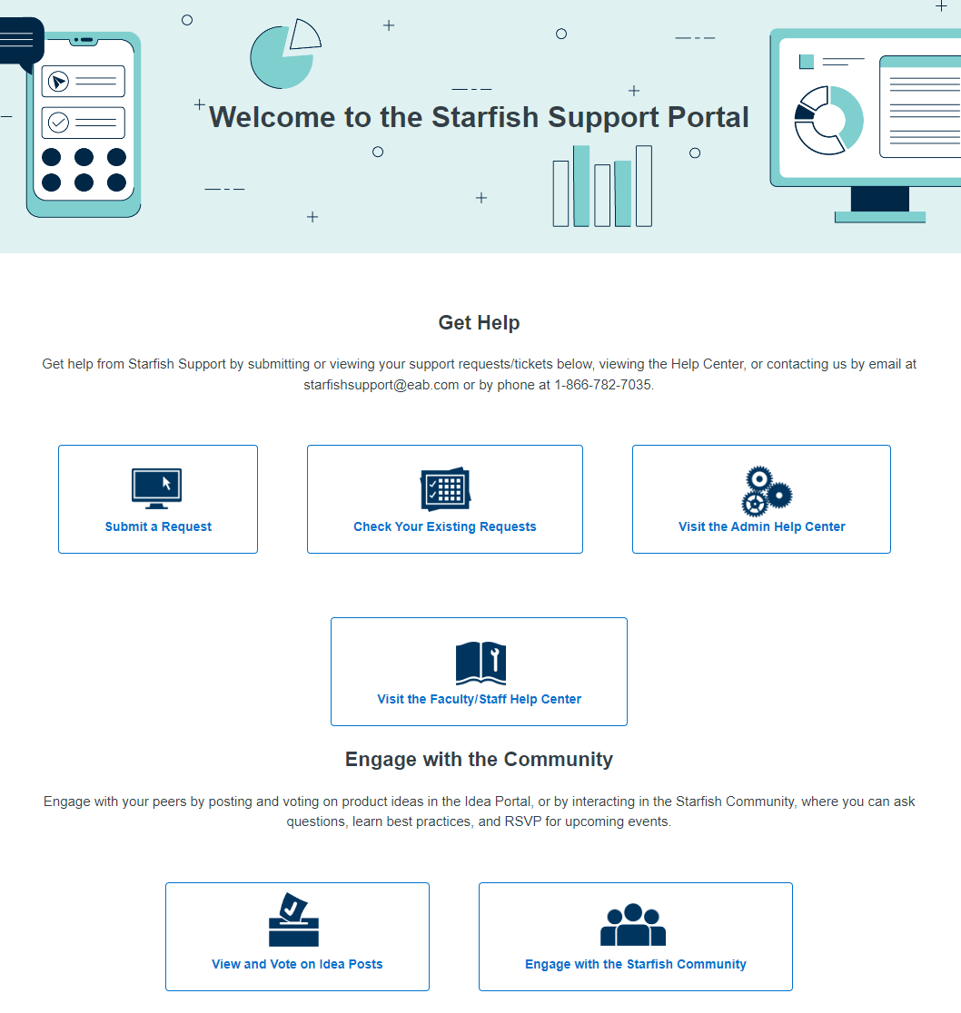
Help!

Slide 31
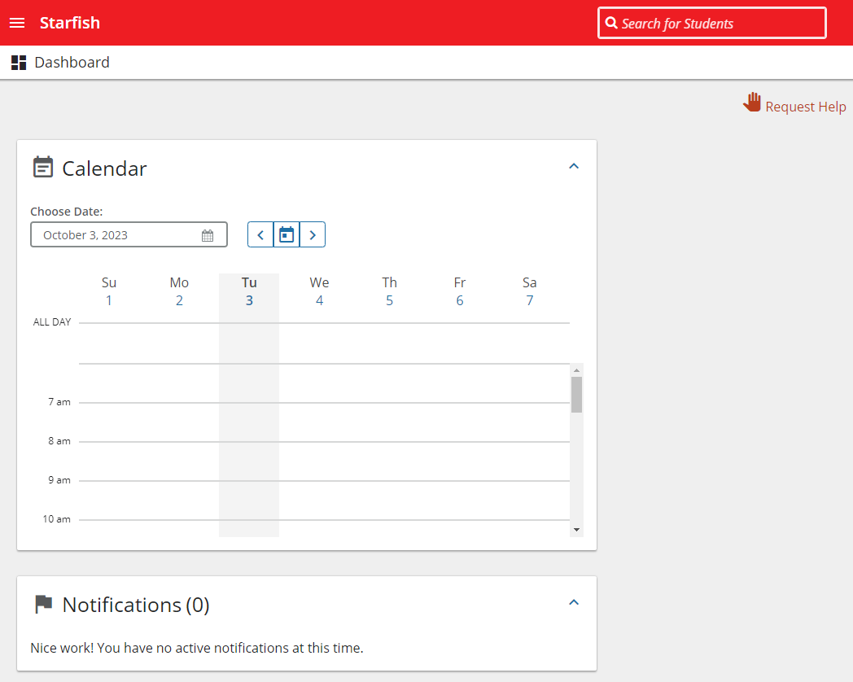
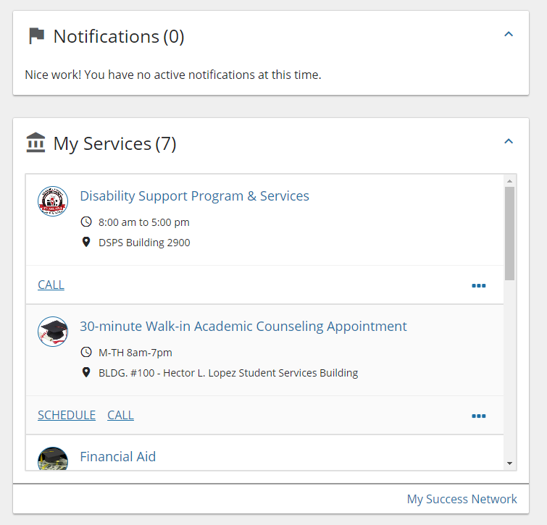
The
Dashboard

Slide 32
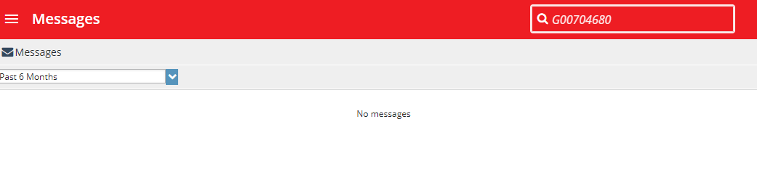
Messages
Copy of messages sent (similar to Canvas inbox)
If Outlook integration is turned on, they will also
be delivered to your mailbox.
System generated messages also go to email address

Slide 33
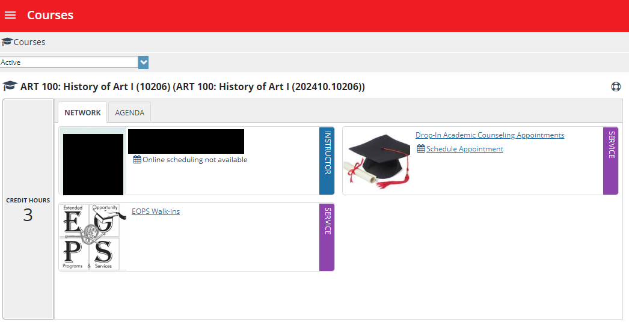
Courses

Slide 34
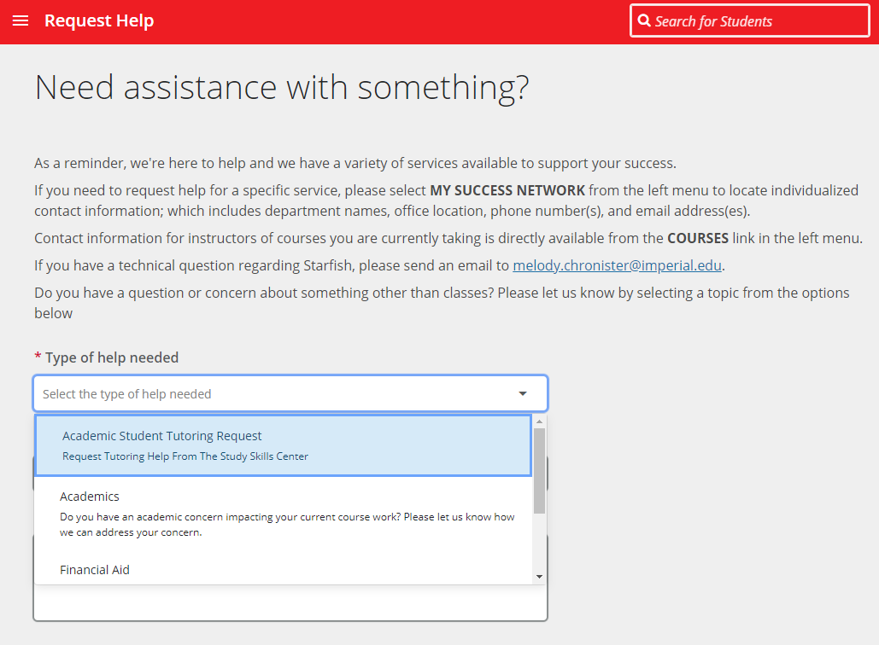
Request Help

Slide 35
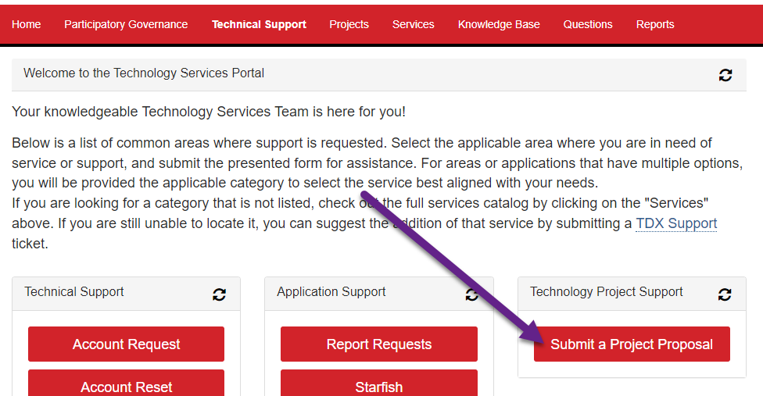
Have Ideas?
Encourage you to collaborate with your colleagues and submit a service ticket.
For larger changes, encourage first taking to Academic Senate for discussion, then submit a project proposal request form.

Slide 36
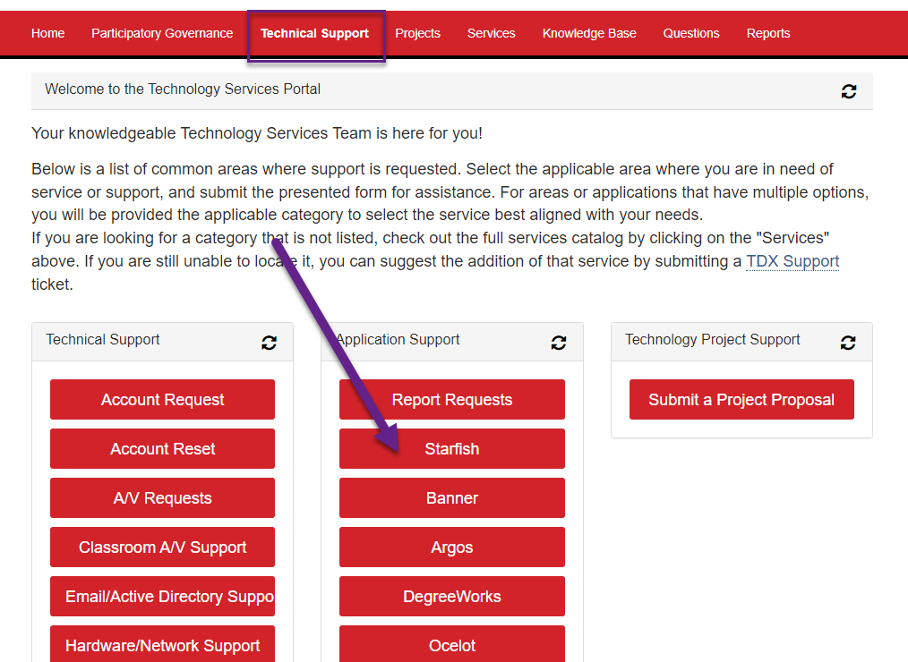
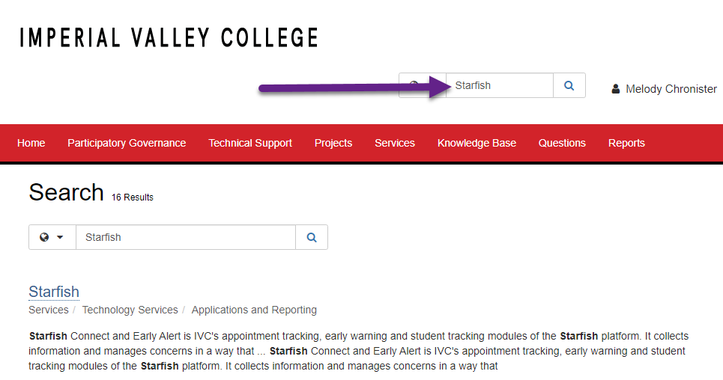
Request Support
Open a ticket to get
support for Starfish

Slide 37

Q&A

