Slide 1
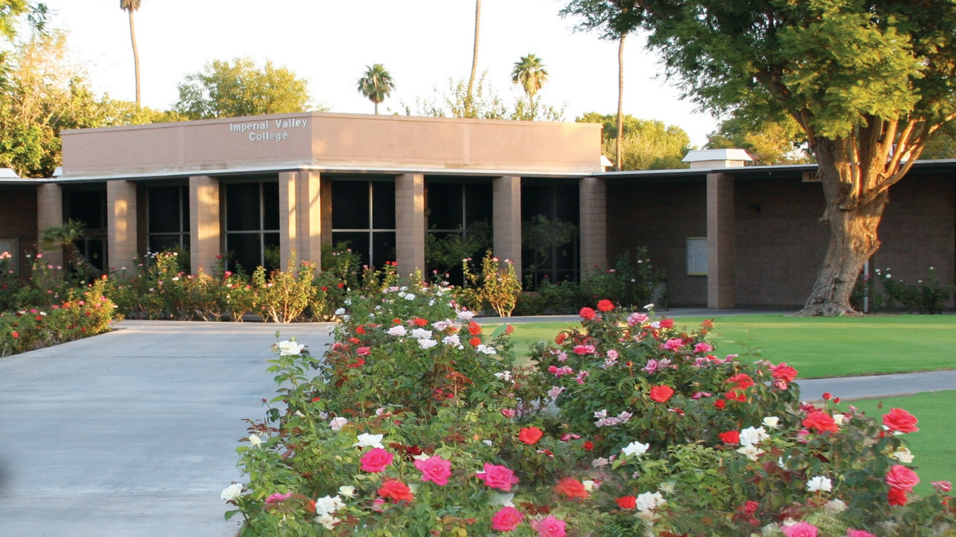


Graduation checklist
Fall 2024, Winter 2025, Spring 2025, Summer 2025 Graduates
HERE IS WHAT YOU NEED TO KNOW!

Slide 2
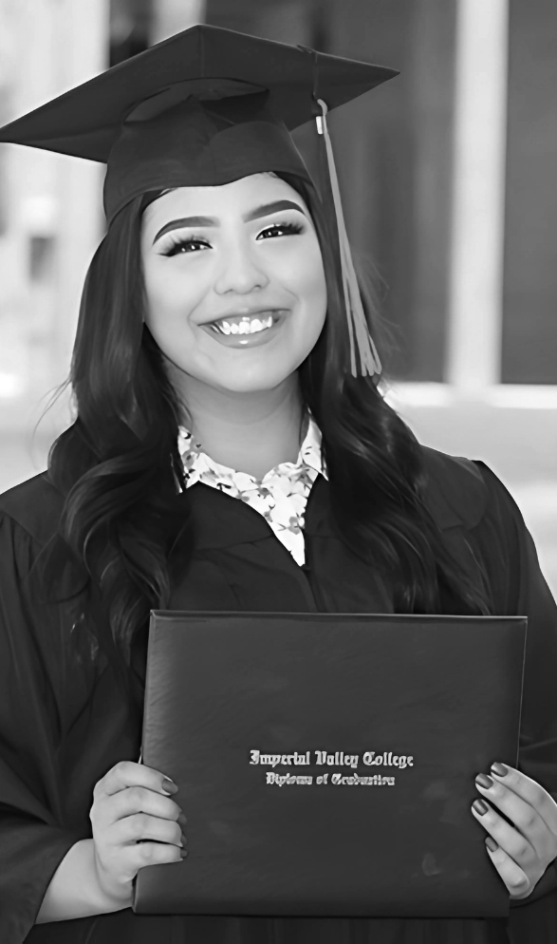








INTRODUCTION
AWARDING PROCESS
Staff that evaluate graduation applications.
A review of the awarding process and schedules for each semester.
Verify INFORMATION
DIPLOMAS & CERTIFICATES
AGENDA
How to check and verify your student information.
Important information regarding Diplomas & Certificates.
TRANSCRIPTS
UNAWARDED STEPS
Information on ordering and sending official transcripts.
Steps to take for students who are not granted a degree/certificate.
GRADUATION HONORS
COMMENCEMENT
Information on how graduation honors are determined.
INFORMATION

Slide 3
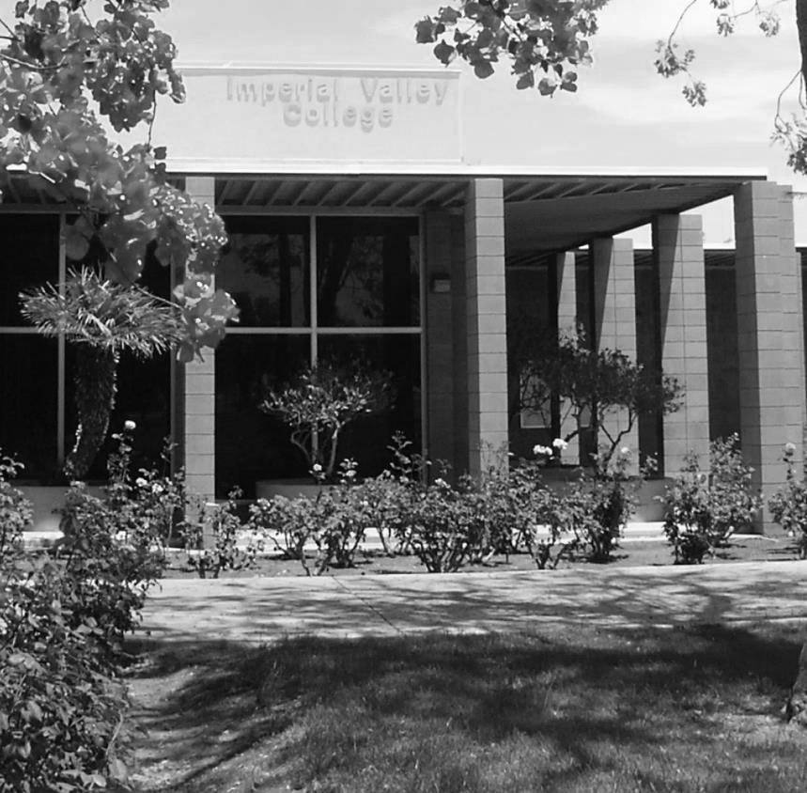



A&R EVALUATORS
JEANETTE ESPINOZA
ALPHA: A-F
jeanette.espinoza@imperial.edu
760-355-6495
Evaluators work on an alpha based system.
If you have any questions related to your graduation application, contact your evaluator by matching your last name to their alpha range. Please use your IVC email and include your G# for a quicker response.
EDGAR LARA
ALPHA: G-N
edgar.lara@imperial.edu
760-355-6204
CEAR SUPNET
ALPHA: O-Z
cesar.supnet@imperial.edu
760-355-6365

Slide 4
AWARDING PROCESS
Submit a graduation application with your academic counselor
01.
02.
Receive an email notification confirming your request.
Evaluator logs it in.
03.
04.
Wait for grades to be rolled. (See next chart)
Evaluations to award degrees/certificates begin.
05.
06.
Degrees/Certificates mailed out. (See next chart)

Slide 5
FALL 2024 SCHEDULE
DECEMBER 07
DECEMBER 13
SEMESTER ENDS
GRADES ARE ROLLED
This is the official last day of the semester.
Instructors have until December 13, 2024, to submit grades.
JANAURY 02
FEBRUARY 13
EVALUATIONS
MAIL OUT
Evaluators begin evaluations after returning from Winter Break.
Diplomas/Certificates are mailed out. Check your mailing address on WebSTAR before January 3, 2025.

Slide 6
WINTER 2025 SCHEDULE
FEBRUARY 3
FEBRUARY 10
SEMESTER ENDS
GRADES ARE ROLLED
This is the official last day of the semester.
Instructors have until February 10, 2025, to submit grades.
FEBRUARY 11
MARCH 21
EVALUATIONS
MAIL OUT
Evaluators begin evaluations for Winter applicants only.
Diplomas/Certificates are mailed out. Check your mailing address on WebSTAR before March 7, 2025.

Slide 7
SPRING 2025 SCHEDULE
JUNE 06
JUNE 13
SEMESTER ENDS
GRADES ARE ROLLED
This is the official last day of the semester.
Instructors have until June 13, 2025, to submit grades.
JUNE 16
JULY 10
EVALUATIONS
MAIL OUT
Evaluators have 8 business days to evaluate over 1000 graduation applications.
Diplomas/Certificates are mailed out. Check your mailing address on WebSTAR before July 10, 2025.

Slide 8
SUMMER 2025 SCHEDULE
JULY 24
JULY 31
SEMESTER ENDS
GRADES ARE ROLLED
This is the official last day of the semester.
Instructors have until July 31, 2025, to submit grades.
AUGUST 04
SEPTEMBER 12
EVALUATIONS
MAIL OUT
Evaluators begin evaluations for Summer applicants only.
Diplomas/Certificates are mailed out. Check your mailing address on WebSTAR before August 07, 2025.

Slide 9



VERIFY STUDENT INFORMATION
Check WebStar for your Mailing Address.
Check WebStar for fees owed.
Check DegreeWorks to verify your Progress, GPA, and name.

Slide 10
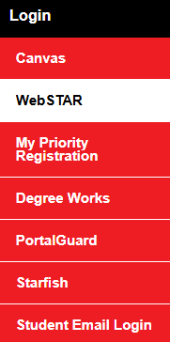
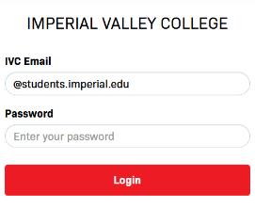
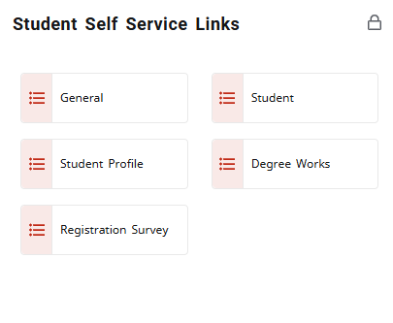



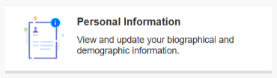
HOW TO CHECK: MAILING ADDRESS
STEP 1:
Go to imperial.edu and click on “WebSTAR” in the “Login” option of the page.
STEP 2:
Login using your IVC Student Email and Password.
STEP 3:
In the “Student Self Service Links” square, click on the “General” option.
STEP 4:
Click on the “Personal Information” option to view and update your information.

Slide 11
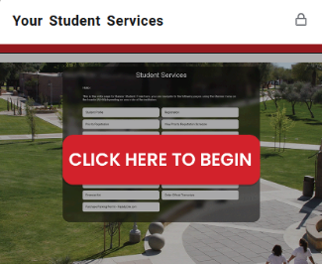



HOW TO CHECK: FEES AND PAYMENTS
STEP 1:
Go to imperial.edu and click on “WebSTAR” in the “Login” option of the page.
STEP 2:
Login using your IVC Student Email and Password.
STEP 3:
In the “Your Student Services” square, select the “Click here to begin.” option.
STEP 4:
Click the “Account Summary” or “Make a Payment using your Credit or Debit Card” option to view your student fees. If you are making a payment, both options include a “Pay Now” button which is located on the top right corner of the page you select.

Slide 12
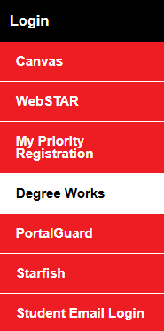
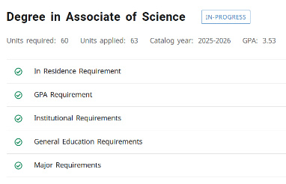
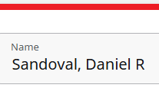
HOW TO CHECK: DEGREE WORKS
STEP 1:
Go to imperial.edu and click on “Degree Works” in the “Login” option of the page.
STEP 2:
Login using your IVC Student Email and Password.
STEP 3:
Check your progress. The GPA in the degree block for which you applied will used, NOT the overall GPA.
STEP 4:
Verify that your name is correct. The name displayed is what will be used for your Degree/Certificate.
NOTE:
You must have a 2.0 GPA for graduation. Your final GPA will be calculated after grades are rolled.
Spring/Summer Commencement Participants: We will use your last GPA available for Commencement purposes.

Slide 13
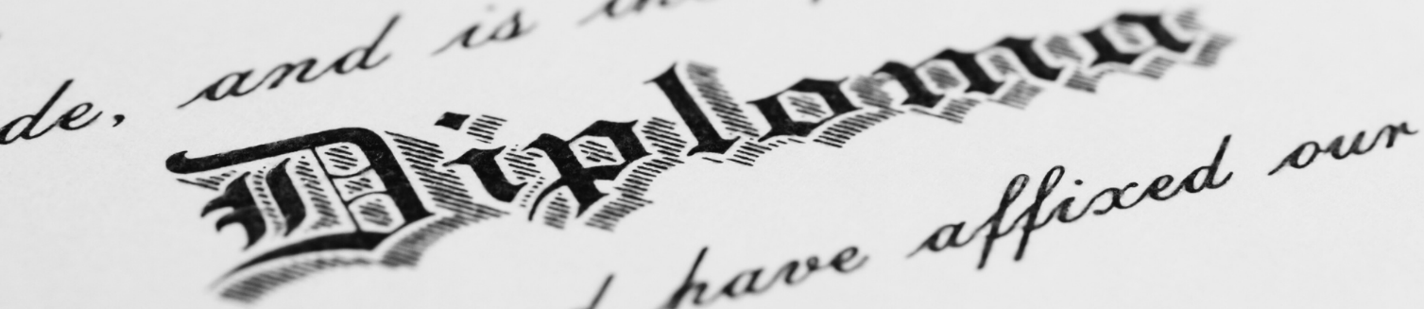
DIPLOMAS & CERTIFICATES
All student who are currently enrolled at IVC and have intent to complete their course work at the end of the Spring semester or Summer session should receive their diploma by mail approximately 8 weeks after the completion of their final course. Students must pay any remaining fees and confirm their mailing address on WebSTAR as this is where your diploma will be sent.
NOTE:
Admissions & Records will not review your graduation petition if you owe any fees.
If you need to request a duplicate diploma/certificate, please visit Parchment.com.

Slide 14
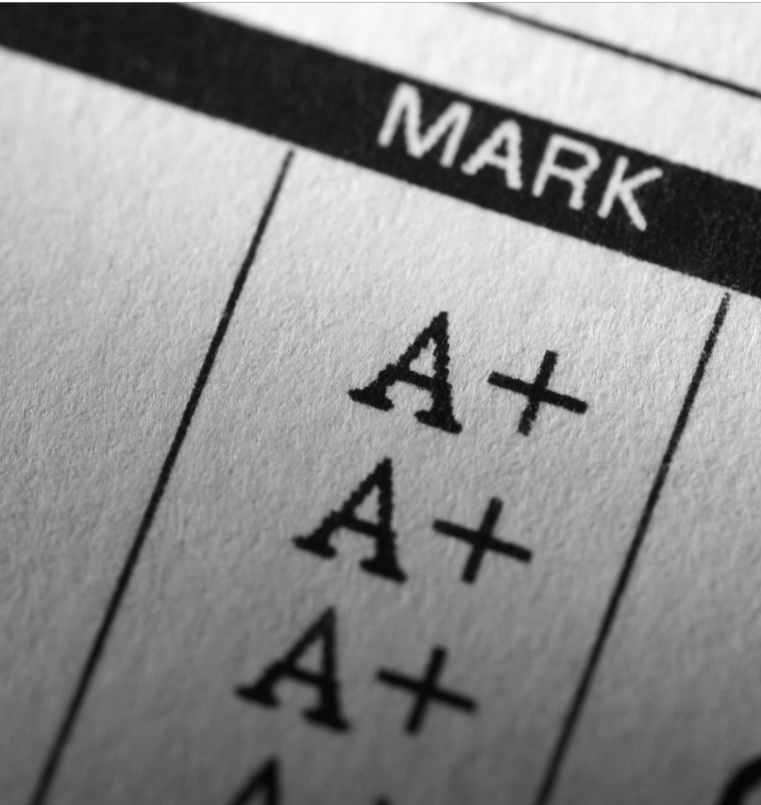


TRANSCRIPTS
Official IVC Transcripts can be requested through WebSTAR or the Parchment website.
There is a transcript fee when ordering any of the two following options below:
e
ELECTRONIC
PRINT & MAILED
Delivered By Email
Printed on Paper & Mailed
$5 per request
$7.75 per request
Tell us when to release your transcript(s)
Hold for posting of current Semester Grades:
Option for current or next semester.

Slide 15
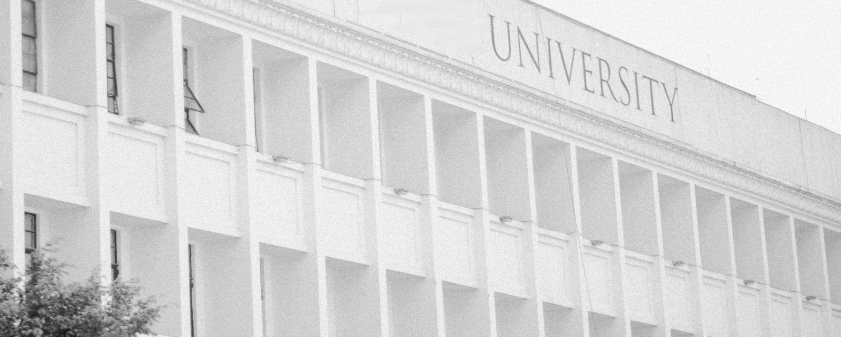
TRANSCRIPTS CONTINUED
If you’ve earned credits at another college, please send us your official transcripts before a graduation application is processed.
This will cause a delay in processing your degree and may prevent you from graduating.
If you have questions, you may email your assigned
Evaluator at admissionsevaluators@imperial.edu
MAIL YOUR TRANSCRIPTS TO:
Imperial Valley College
Attn: Admissions & Records
380 E. Aten Road
Imperial, CA 92251

Slide 16
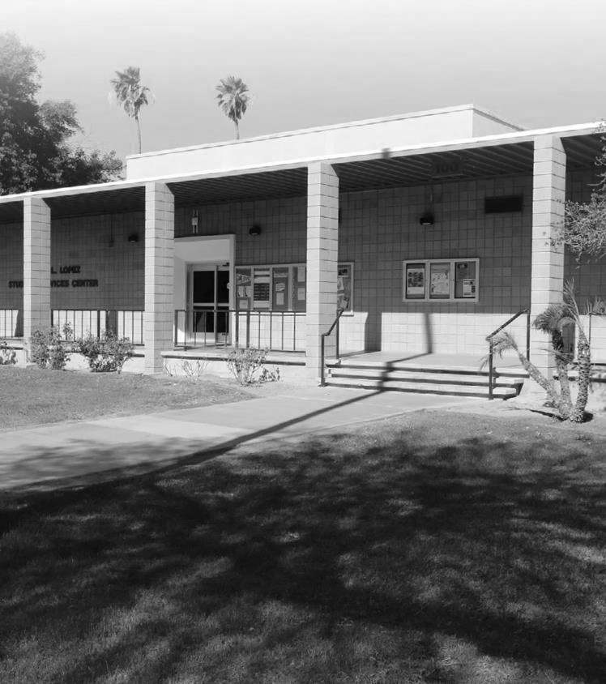



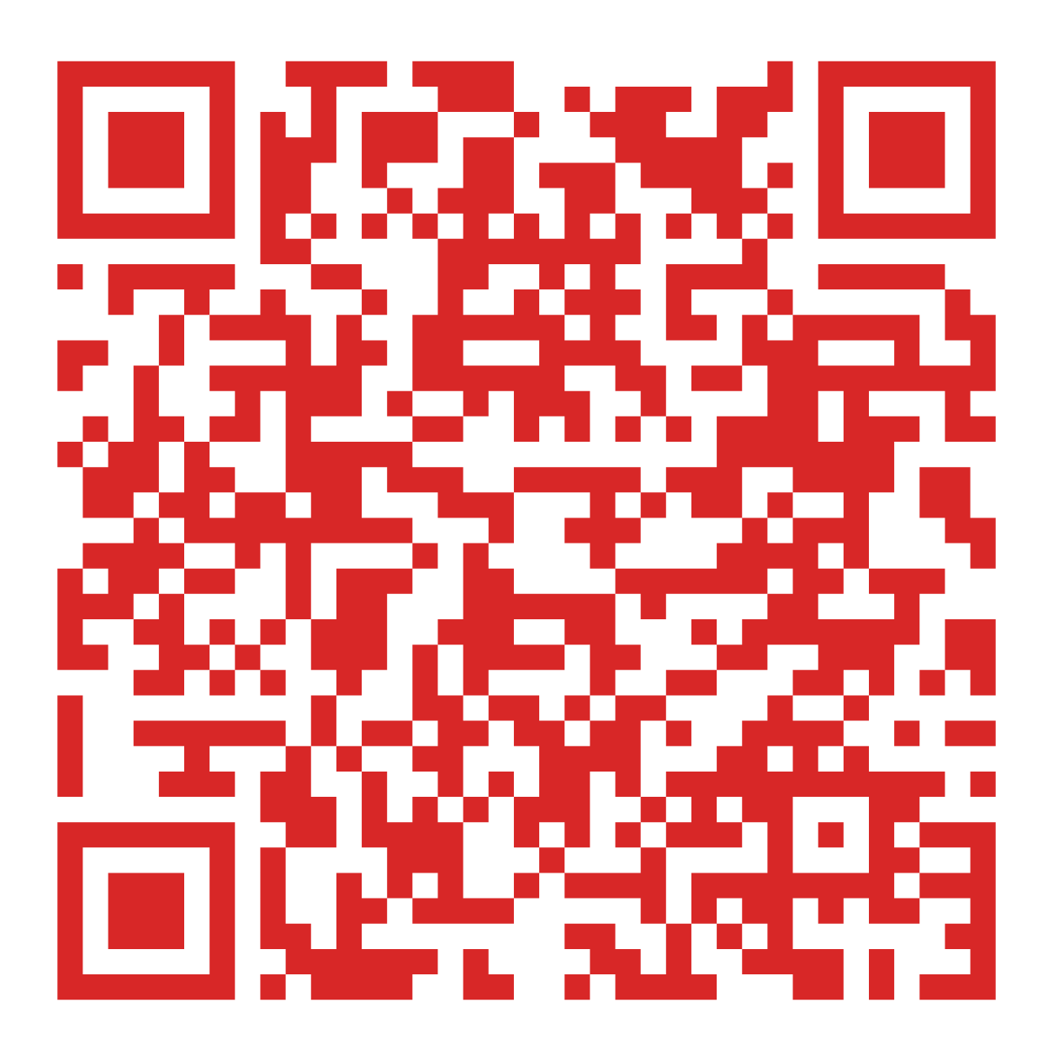

NOT AWARDED? TAKE THESE 4 STEPS
Review the email notifying your awarded status that is sent to your IVC email.
Review your progress in DegreeWorks to view any missing requirements needed to be awarded.
Contact your academic counselor to apply for the next semester to complete your missing coursework.
Re-apply for graduation after meeting all requirements.
Please scan the QR code to view Important Dates and Deadlines:

Slide 17
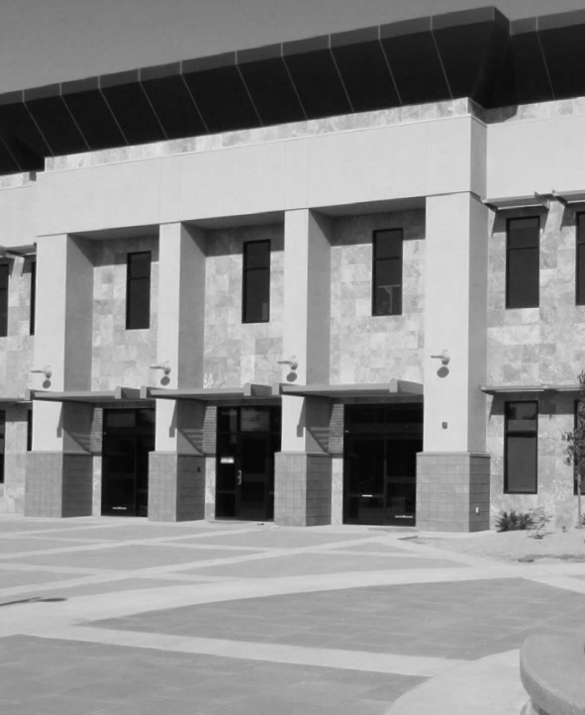
GRADUATION HONORS
GRADUATION HONORS ARE BASED ON GPA
For students earning an AA or AS, GPA is calculated with all Degree Applicable coursework from all colleges attended.
For students earning an AA-T or AS-T, GPA is calculated with all CSU transferable coursework from all colleges attended.
WITH HONORS: 3.0 -3.49
WITH DISTINCTION: 3.5 – 4.0
SPRING OR SUMMER GRADUATES
Grades for students that are completing their coursework in the Spring or Summer 2025 semester AND participating in Commencement, will not be posted until after the ceremony. IVC will use the GPA from the last attended semester to determine your honors status (e.g. Fall 2024 or Winter 2025).

Slide 18
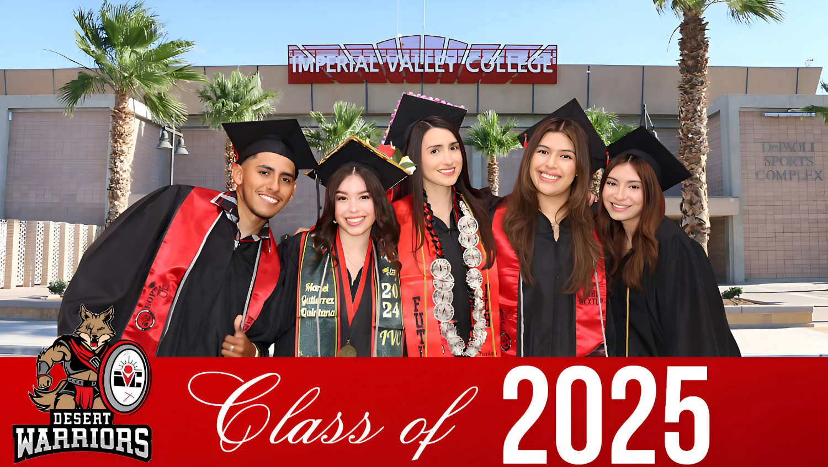

COMMENCENT INFOrMATION
Class
of
2025

Slide 19
COMMENCENT TIMELINE
GRADFEST (MAY 19, 2025): | Gradfest will be held in the College Center (Bldg. 600) from 11:30 a.m. to 1:00 p.m.​
REGALIA PICK UP (May 27/28/29/30, 2025): | Graduates may begin to pick up regalia packages in room 624, Tuesday-Thursday, 8:30 a.m. to 6:00 p.m. and Friday 8:30 a.m. to 12:30 p.m.​
COMMENCEMENT REHEARSAL (June 6, 2025): | Commencement Rehearsal will be held in the Gym from 9:30 a.m. to 11:00 a.m. NOTE: The Regalia is NOT required to wear at the rehearsal.
COMMENCEMENT CEREMONY (June 8, 2025): | Graduates must report to the library in their regalia at the time below: For the 9:00 a.m. Ceremony: Report @ 8:00 a.m.​ For the 2:00 p.m. Ceremony: Report @ 1:00 p.m.​
ADDRESS CORRECTION (June 14, 2025): | Verify that your mailing address is correct on WebSTAR as this is where your diploma will be mailed to.​
DIPLOMAS (JuLY 26, 2025): | If you have completed all coursework for your degree, a diploma will be mailed to the address on file in WebSTAR.

Slide 20
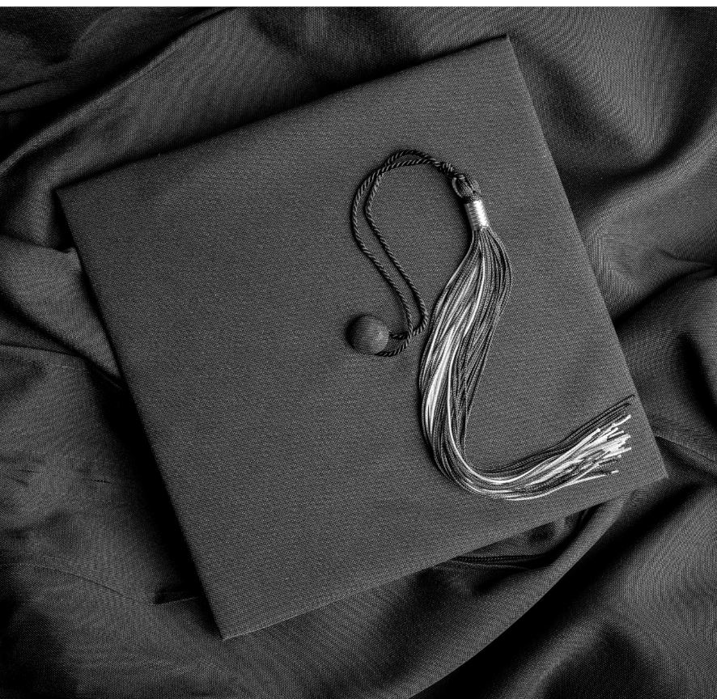
REGALIA PACKAGE
Cap
Gown
Tassel
Academic Cord (if merited)
Diploma cover
Ceremony reception
All graduates must wear their regalia to the ceremony and gowns must be fully zipped up.
Any stole or cap decoration that is deemed inappropriate or offensive will be removed by commencement staff or the gradate may be removed from the ceremony.

Slide 21

RECEPTION
Professional photographers will be stationed at the ceremony and will photograph you receiving your diploma.
You will be emailed the proofs and the link to view and purchase your pictures to the email address provided on the card reader as well as your IVC student email account.
Picture prices start at $9.95 for a single photo. Packages are available for purchase through our third-party vendor.
We ask that family members please not come down from their seats to take pictures as this will interfere with the procession.

Slide 22
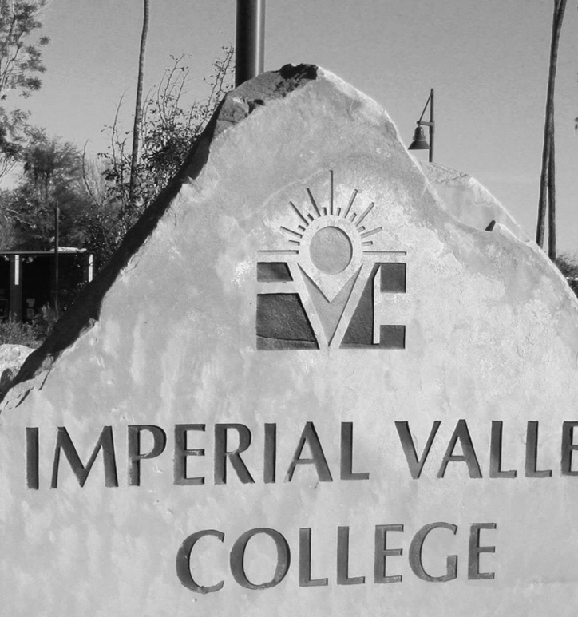
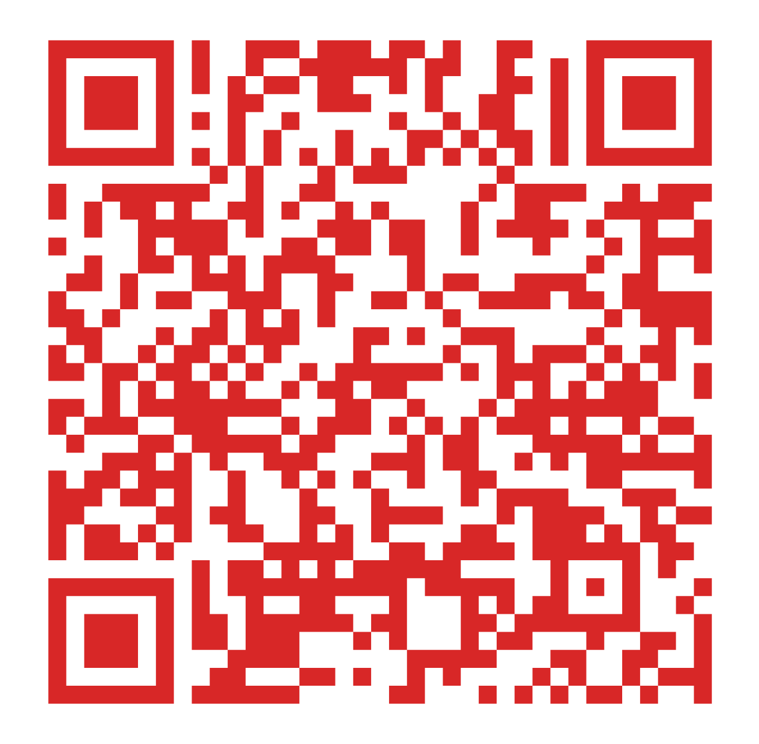
COMMENCEMENT QUESTIONS
For more Commencement information, please visit our website by scanning the QR code below:
Yareli Rivera
Director of Student Activities
studentaffairs@imperial.edu
(760) 355-6455
For questions regarding Commencement, please refer to the following Student Affairs Department contact information:

Slide 23
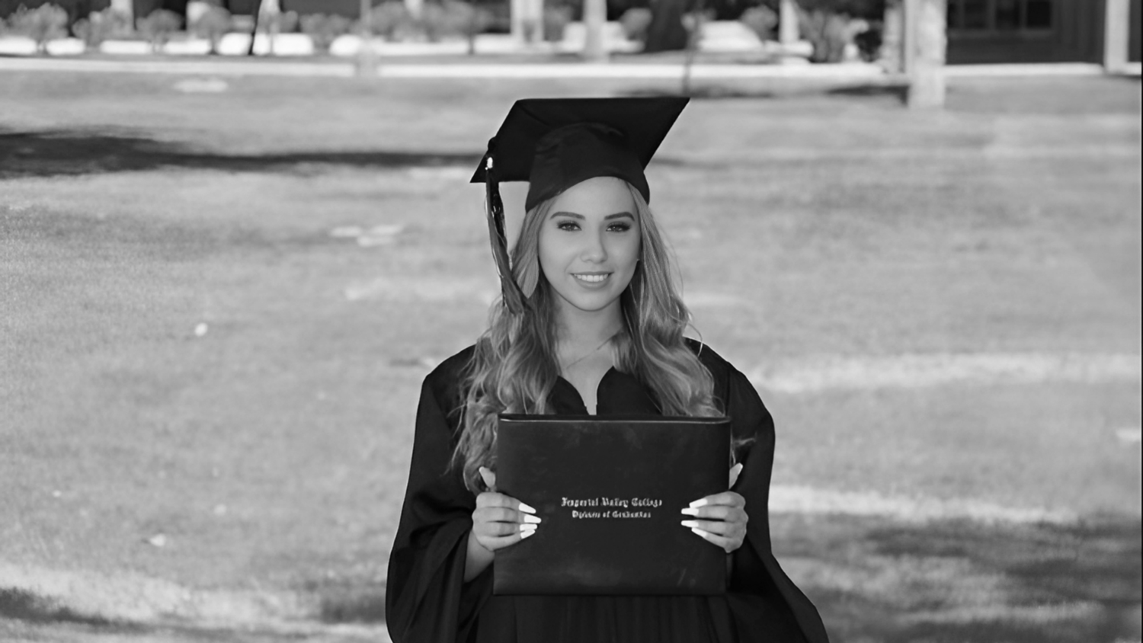
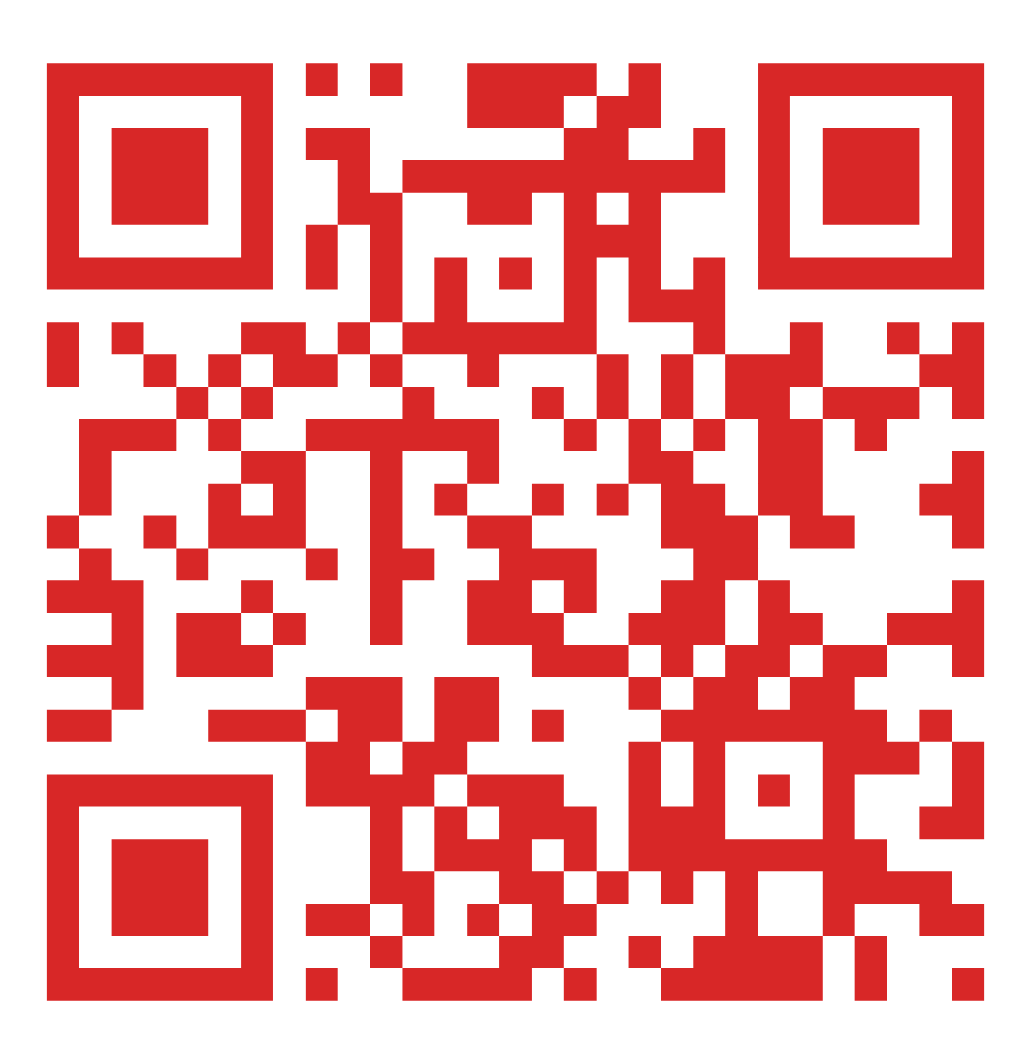
GENERAL QUESTIONS?
Visit Admissions & Records in Building 10 or call (760) 355-6101.
You may also scan the QR code below to connect with us on Zoom:
Zoom Hours:
Monday-Friday from 2-4PM.

